Slide 1
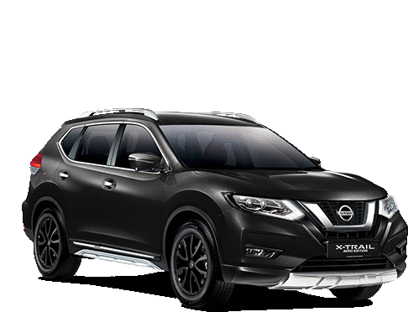
Fuel Economy Analysis
Regression Team
Emily Tesch
Mohsen Parsa
Ke-Shao(Derek) Wu
Luc Teachout
Sai Swaroop Reddy Vennapusa

Slide 2
Fuel Economy
Fuel efficiency or fuel economy refers to the energy efficiency of a vehicle. This is reported as a ratio of distance traveled vs fuel consumed. In the US this is miles per gallon or MPG.

Slide 3


Why care about fuel economy?
Notes:
Save money and the planet by using less gas!
Average across fleet by manufacturer – encourage manufacturers to

Slide 4
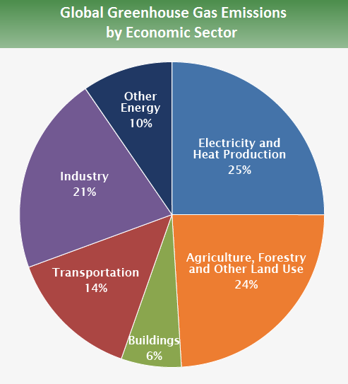
Climate Perspective
Transportation contributes 14% of global greenhouse gases
Smog forming emissions
CO₂
EPA, 2010
Notes:
The combustion of gas to fuel vehicles emits both greenhouse gasses (primarily carbon dioxide) and smog forming emissions
Nitrogen oxide, non-methane organic gases, carbon monoxide, particulate matter, and formaldehyde
Trapped close to the ground forming a haze
Difficult to breathe- especially in populations with lung issues like asthma emphysema and chronic bronchitis
Carbon dioxide
Stay in the atmosphere for 100 yrs or more
Trap energy in the atmosphere causing warming
https://www.epa.gov/ghgemissions/global-greenhouse-gas-emissions-data

Slide 5
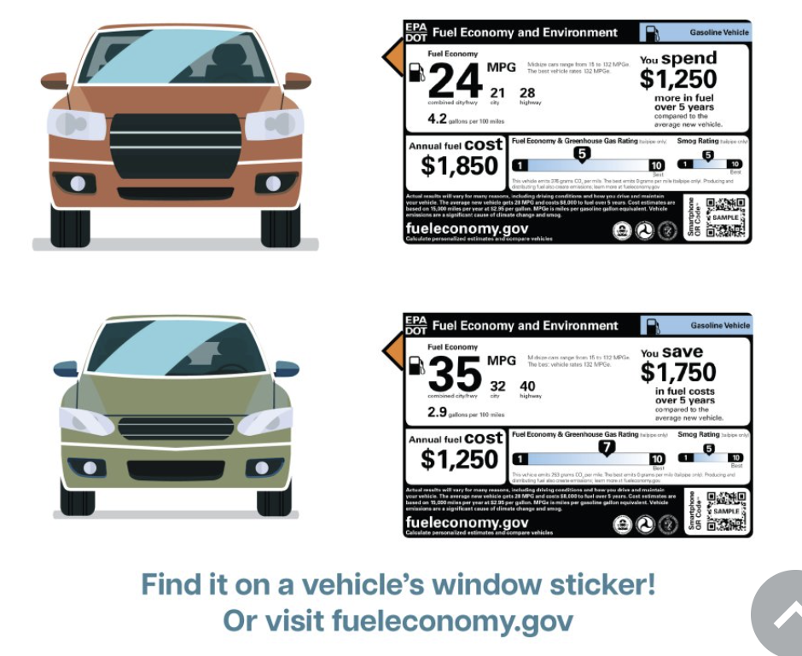
Consumer Perspective
Fuel economy information is now displayed on cars when you buy them for comparison.
Notes:
EPA fuel economy and environment information is readily available to consumers

Slide 6
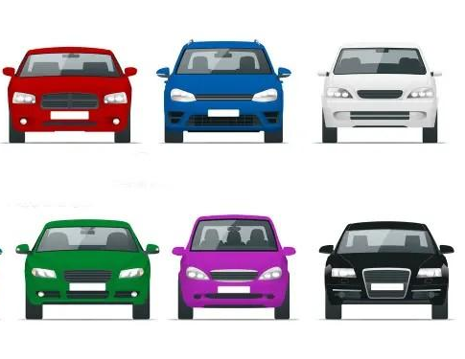
Manufacturer Perspective
Under 49 CFR Part 531, car manufacturers are required to meet a fleet-wide MPG average requirement that becomes stricter each year.
The gas guzzler tax applies to passenger cars and is paid by manufacturers and importers.
It would be useful to predict the MPG given the fleet characteristics.
Notes:
EPA fuel economy and environment information is readily available to consumers
Gas guzzler tax applies to passenger vehicles (Trucks, minivans, and sport utility vehicles (SUV) are not covered because these vehicle types were not widely available in 1978 and were rarely used for non-commercial purposes.)

Slide 7
Research Questions
Do any car manufacturers consistently outperform others in fuel efficiency?
How does horsepower impact fuel efficiency?
How does the weight of a vehicle impact fuel efficiency?
To address with statistical analysis of available EPA data
Notes:
Consumer
Manufacturer
Manufacturer

Slide 8
Data
Testing Facilities
Simulation Techniques
Adherence to Standards
Provided by the US EPA
Notes:
Each year, EPA provides fuel economy data to the Department of Energy (DOE), the Department of Transportation (DOT) and the Internal Revenue Service (IRS) so that they can administer their fuel economy-related programs.
Description of Data Collection for 2023:
Testing Facilities:
The primary testing was conducted at the National Vehicle and Fuel Emissions Laboratory in Ann Arbor, Michigan.
This facility is equipped with advanced technology and simulation tools, ensuring precise and controlled testing conditions.
Simulation Techniques:
State-of-the-art simulation techniques were likely employed to replicate real-world driving scenarios.
Testing procedures considered diverse driving conditions, including urban, highway, and various environmental factors.
Adherence to Standards:
The data collection for 2023 adheres to the latest EPA testing standards, reflecting the evolving automotive industry landscape.
Sampling Methodology for 2023:
Diverse Vehicle Models:
The sampling included a diverse range of vehicle models, covering different sizes, fuel types (gasoline, hybrid, electric), and classes.
This approach provides consumers with a comprehensive overview of fuel economy across various automotive segments.
Incorporation of Advanced Technologies:
The sampling strategy considered vehicles equipped with the latest fuel-efficient technologies, including advanced engine designs and alternative powertrains.
Reliability of 2023 Data:
Quality Control Measures:
Rigorous quality control measures were implemented during the testing process, including regular equipment calibration and validation checks.
These measures ensure the accuracy and reliability of the collected data.
Manufacturer Accountability:
Manufacturers are held accountable for the accuracy of the data they submit.
Compliance with testing standards is closely monitored, and non-compliance can lead to regulatory consequences.
Real-World Applicability:
While laboratory testing provides valuable insights, the EPA strives to balance standardized testing with real-world applicability.
Continuous efforts are made to enhance testing procedures based on feedback and technological advancements.
Conclusion:
The 2023 Fuel Economy Guide data is the result of a meticulous data collection process involving cutting-edge testing facilities, diverse sampling methodologies, and a commitment to reliability. The EPA's adherence to standards, stringent quality control, and ongoing efforts for improvement contribute to the accuracy and relevance of the data, providing consumers and regulatory bodies with valuable information for making informed decisions and enforcing standards in the automotive industry.

Slide 9
Variables |  | Type | Units
Response | Fuel Economy | Continuous | miles per gallon
Predictor | Rated Horsepower | Continuous | horsepower
 | Equivalent Test Weight | Continuous | pounds
 | Number of Gears | Continuous
 | Vehicle Manufacturer | Categorical
 | Transmission Type | Categorical
 | Drive System | Categorical
 | Fuel Type | Categorical

Slide 10
Linear Model and Diagnostics

Slide 11
Linear regression models
mod=lm(pr$`Fuel Economy(MPG)`~(pr$`Vehicle Manufacturer Name`))
23 manufacturers, 10 with significant p-values for their coefficients
mod2=lm(pr$`Fuel Economy(MPG)`~pr$`Rated Horsepower`)
Hypothesis testing showed a linear relationship
mod3=lm(pr$`Fuel Economy(MPG)`~pr$`Equivalent Test Weight (lbs.)`)
Hypothesis testing showed a linear relationship

Slide 12
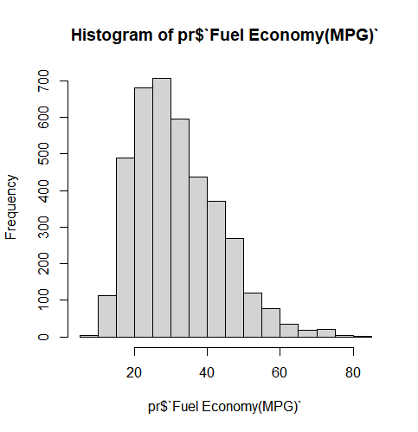
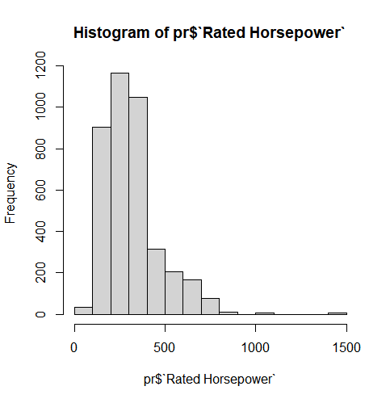
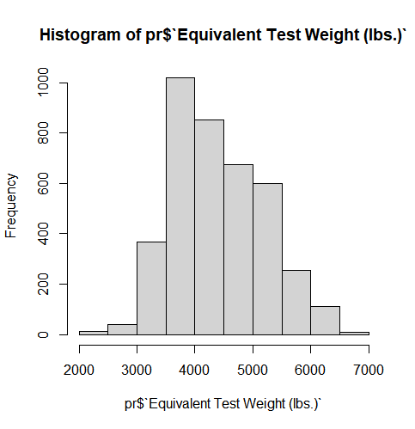
Variable Distributions

Slide 13
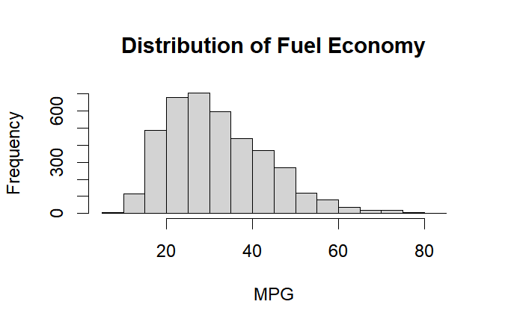
Summary:
Min. 1st Qu. Median Mean 3rd Qu. Max.
8.90 23.10 29.90 31.87 39.20 82.80

Slide 14
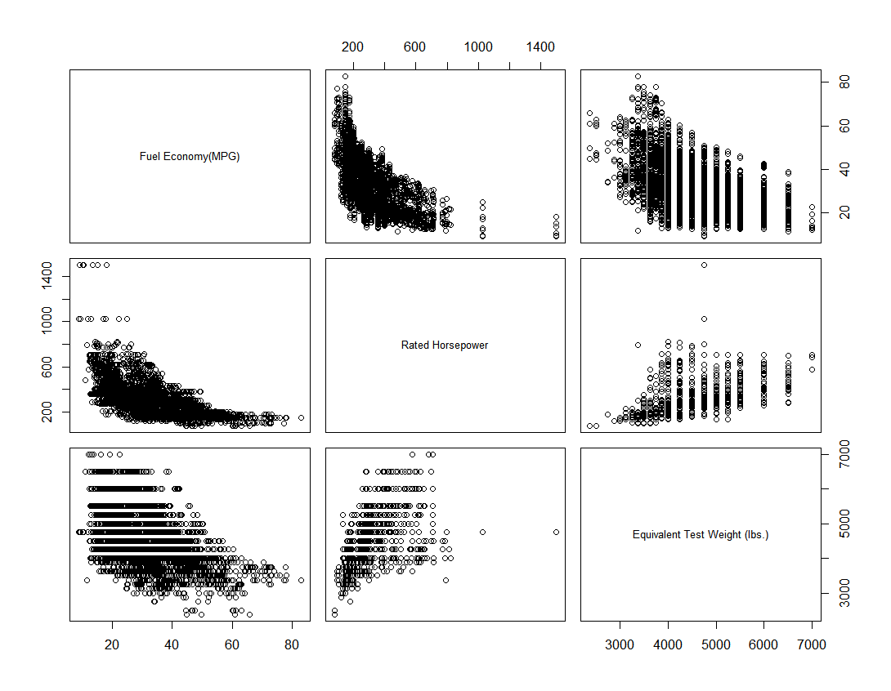

Slide 15
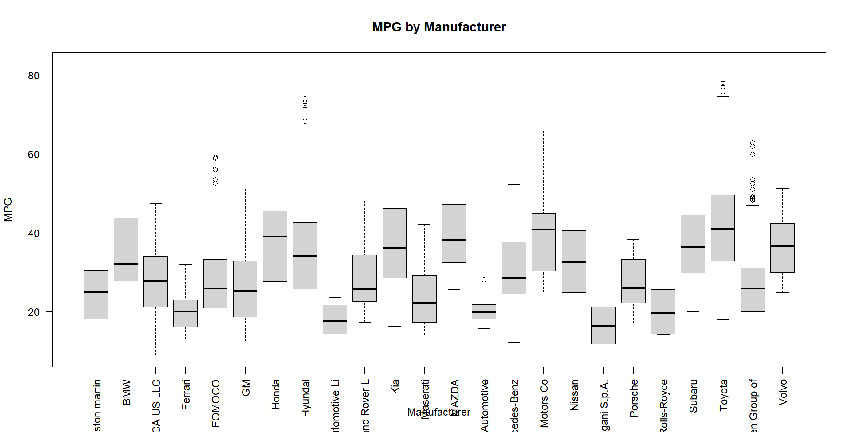
Mitsubishi
Coefficient p-value ~=0

Slide 16
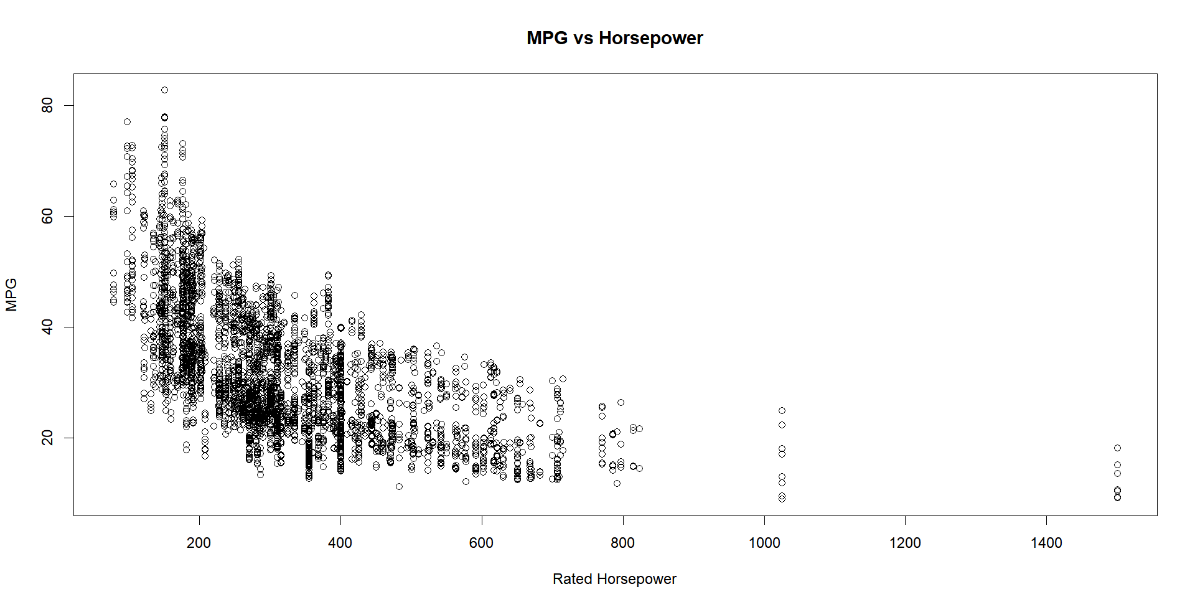
Correlation coefficient = -0.597394

Slide 17
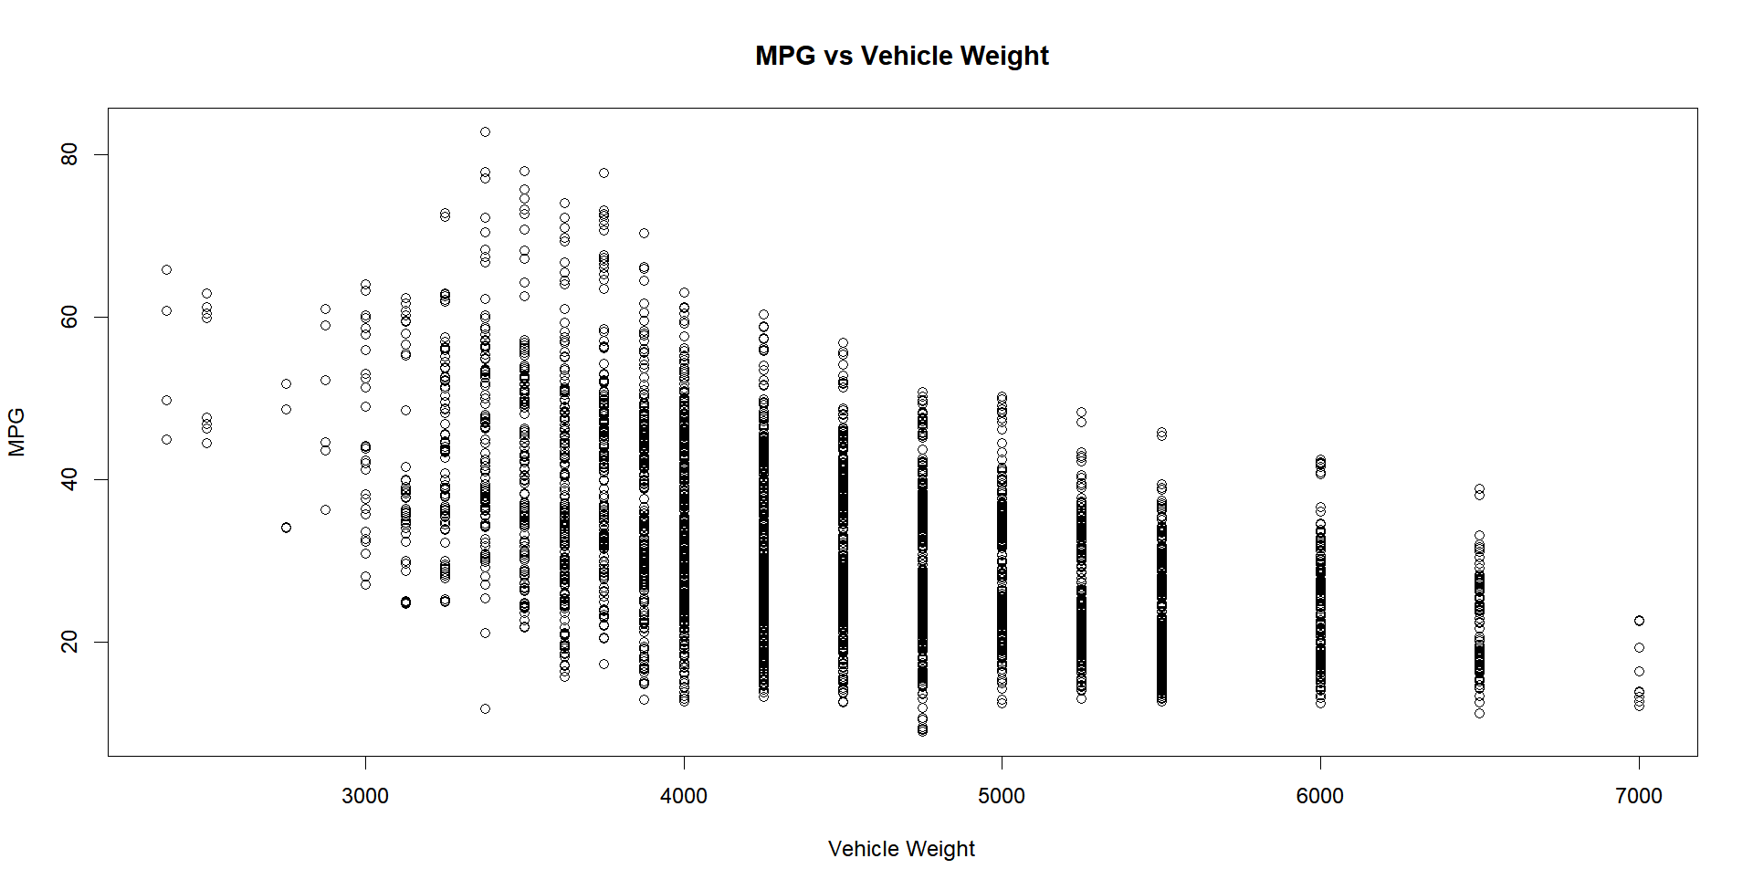
Correlation Coefficient = -0.4931148

Slide 18
Quadratic Model and Diagnostics

Slide 19
Regression Models
Fuel Economy(MPG)=81.52 − 0.1188×Rated Horsepower + 0.00003029×Rated Horsepower^2 − 0.007375×Equivalent Test Weight (lbs.) + 0.00001202×(Rated Horsepower:Equivalent Test Weight (lbs.))
Fuel Economy(MPG) = 30.52 - 0.04472*centered_hp + 0.00003029*centered_hp^2 - 0.003501*centered_weight + 0.00001202*(centered_hp:centered_weight))
After Hypothesis Test for the square term: Because the p-value(2.2e-16) for `I(centered_hp^2)` is less than alpha = 0.05 (in fact, it's much smaller, indicating a highly significant result), we reject H_0 at the significance level of 0.05. This means that the full model, which includes the squared term of the centered `Rated Horsepower` variable, fits the data significantly better than the reduced model without this term. Therefore, we conclude that the squared term of `Rated Horsepower`—after centering—does contribute to explaining the variance in `Fuel Economy(MPG)` and should be retained in the model.

Slide 20
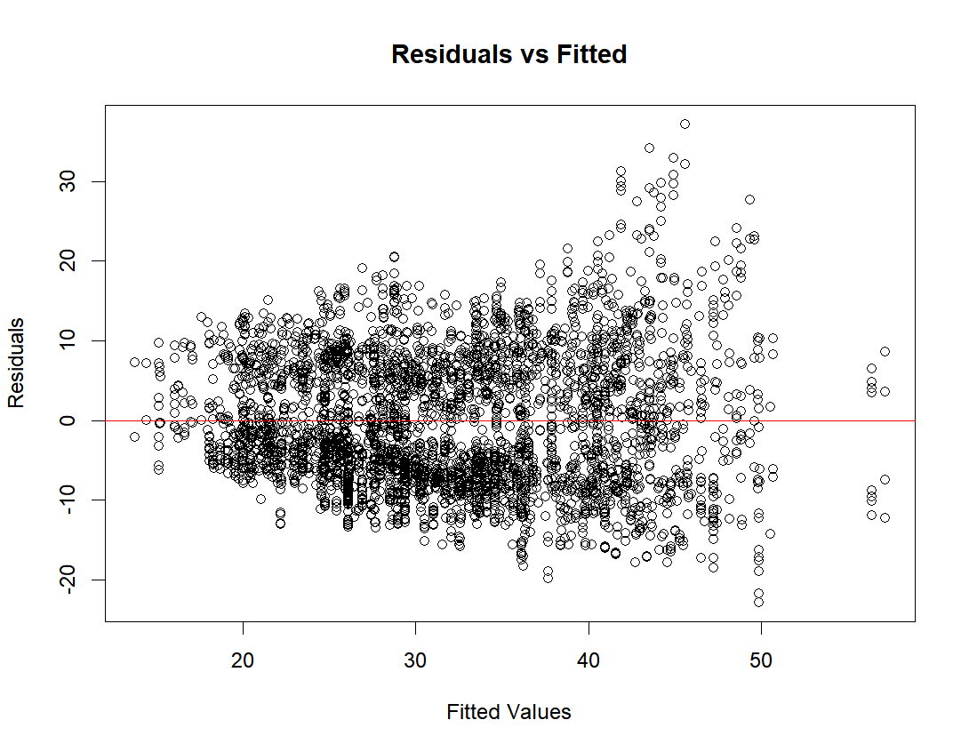

Slide 21
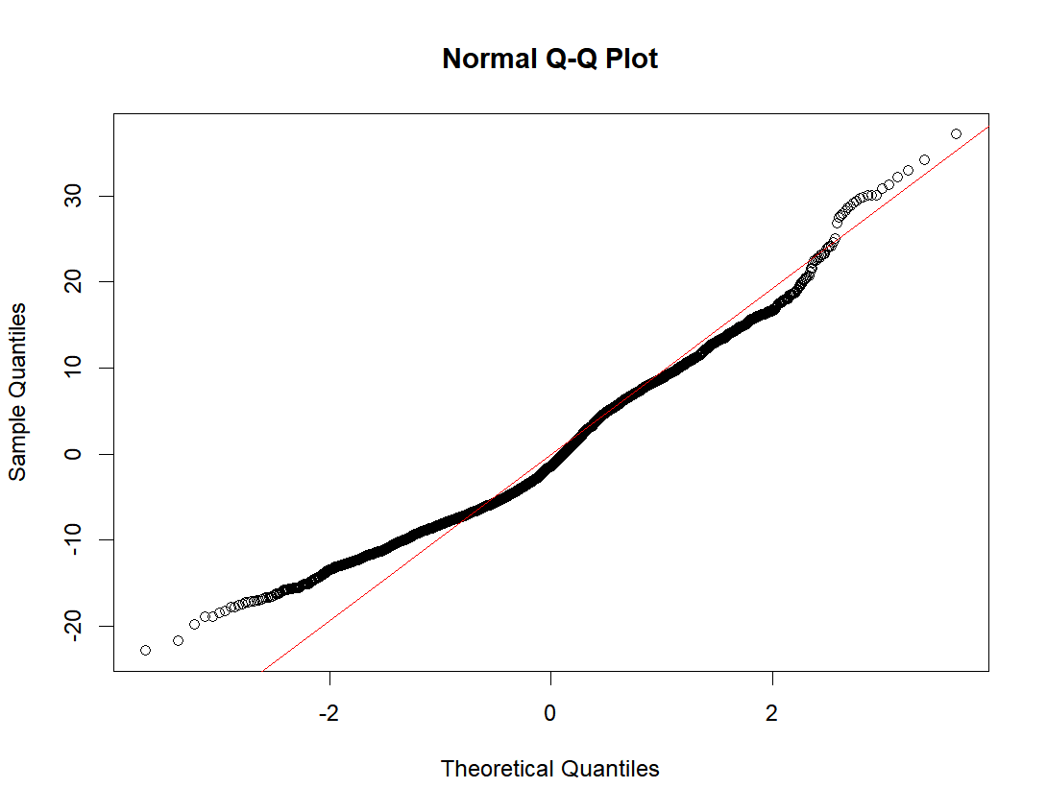

Slide 22
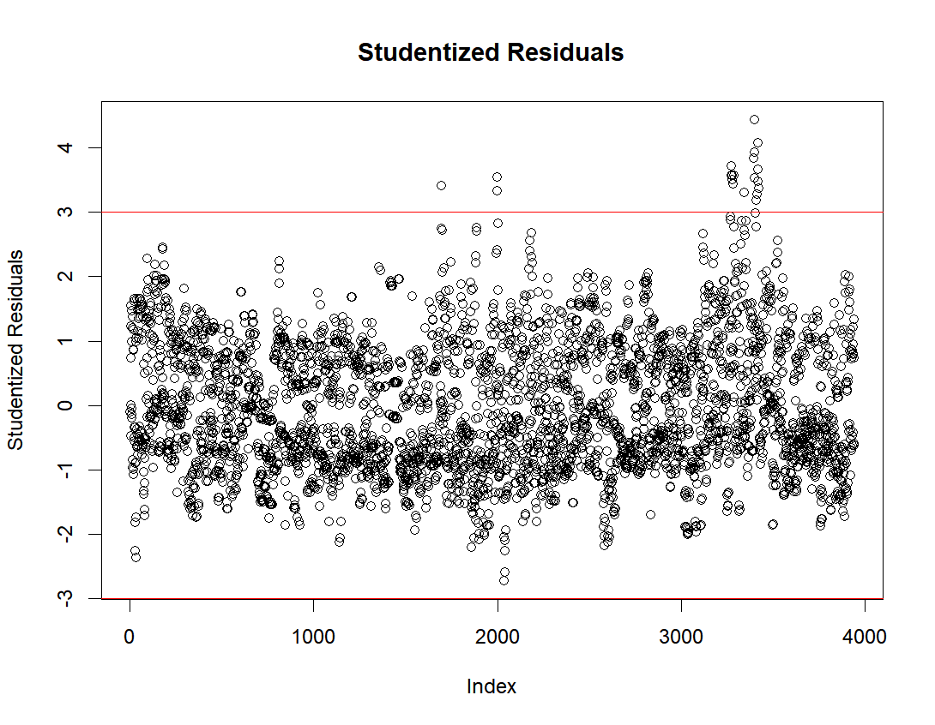

Slide 23
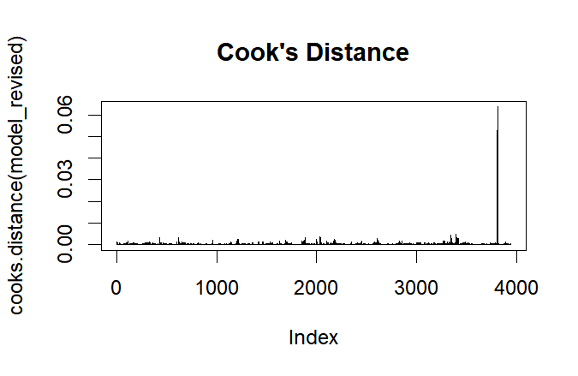

Slide 24
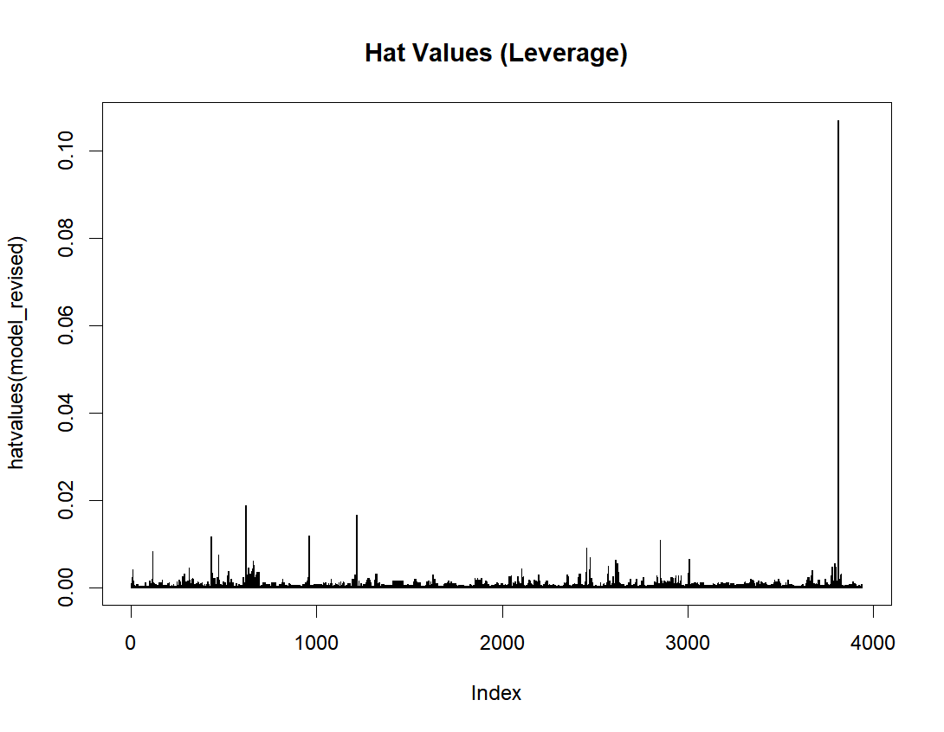

Slide 25
Conclusions
Manufacturer performance is variable.
Horsepower is a significant predictor of MPG
Vehicle weight is a significant predictor of MPG
Horsepower and weight influence each other
Do any car manufacturers consistently outperform others in fuel efficiency?
How does horsepower impact fuel efficiency?
How does the weight of a vehicle impact fuel efficiency?

Slide 26
Discussion
Modeling MPG efficiency can help manufacturers focus their efforts
Eco conscious or frugal consumers can look for cars with better MPG
And future directions

Slide 27
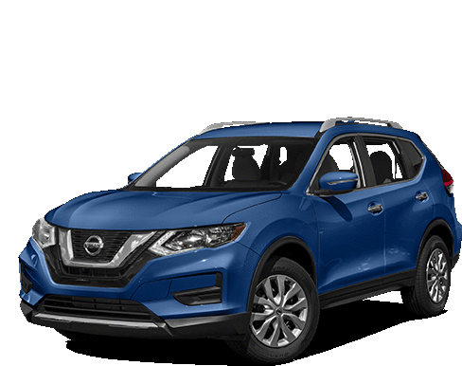
Questions?

Slide 28
References
Data on cars used for testing fuel economy | US EPA. United States Environmental Protection Agency. (2023a, October 25). https://www.epa.gov/compliance-and-fuel-economy-data/data-cars-used-testing-fuel-economy
Gas guzzler tax | US EPA - U.S. Environmental Protection Agency. United States Environmental Protection agency. (2023, October 26). https://www.epa.gov/fueleconomy/gas-guzzler-tax
Global Greenhouse Gas Emissions Data | US EPA. United States Environmental Protection Agency. (2023a, February 15). https://www.epa.gov/ghgemissions/global-greenhouse-gas-emissions-data
Learn about the fuel economy label | US EPA. United States Environmental Protection Agency. (2023b, October 31). https://www.epa.gov/greenvehicles/learn-about-fuel-economy-label
Smog vehicle emissions | US EPA. United States Environmental Protection Agency. (2023c, August 28). https://www.epa.gov/greenvehicles/smog-vehicle-emissions

Slide 29
Extra Slides:

Slide 30
Save Money Too!
Notes:
Save fuel to reduce emission and save money
How much you'll save or spend on fuel over the next five years, compared to the average new vehicle
Ratings on a vehicle's smog and greenhouse gas (GHG) emissions
Driving range and charging time for electric vehicles
QR Code® to access additional information online on your smartphone

Slide 31
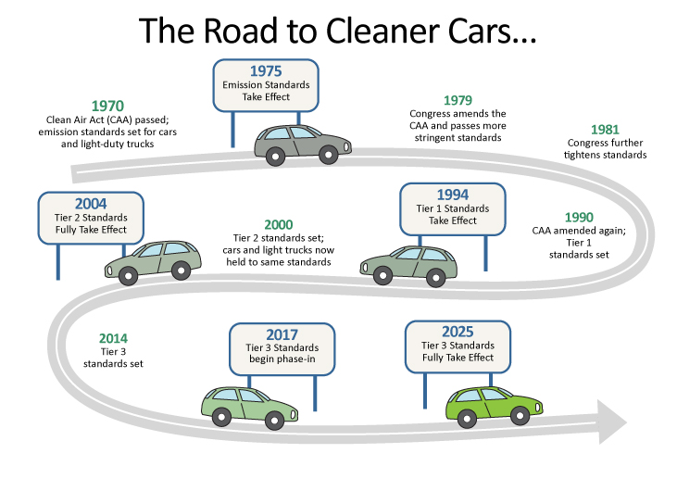
Notes:
In an effort to limit emissions the Clean Air Act passed in 1970 and emissions standards took effect in 1975 meaning vehicles were tested for efficiency and emissions
1975 avg 13 mpg today 25 mpg

